Slide 1
Introduction to Computer Science (371-1-1601)
Lectures by: Dr. Dan Vilenchik & Dr. Zion Siksik
Recitations by: Ariel Cohen, Moshiko Davidian, Assaf Livne, Yair Mazal

Slide 2
Recitation 4 Lists

Slide 3
Today's topics
Mutable vs. immutable variables
Lists – assignment, indexing and methods
paramteres

Slide 4
Mutable vs. Immutable Variables
Mutable
Immutable
Mutable types can be changed after allocated to memory.
As we shall see later, this can:
Be handy
Be risky and requires caution
Immutable types cannot be changed after allocated to memory.
Trying to “change” results in an error or reallocation depending on syntax

Slide 5
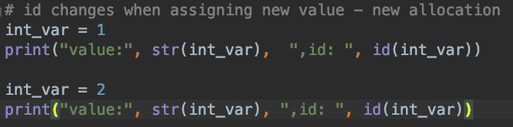
Immutable types
Numeric types are immutable (int, float(.
Reassigning allocates a new value to memory.
This can be seen looking at the id, which corresponds to the address which stores the value.

Slide 6
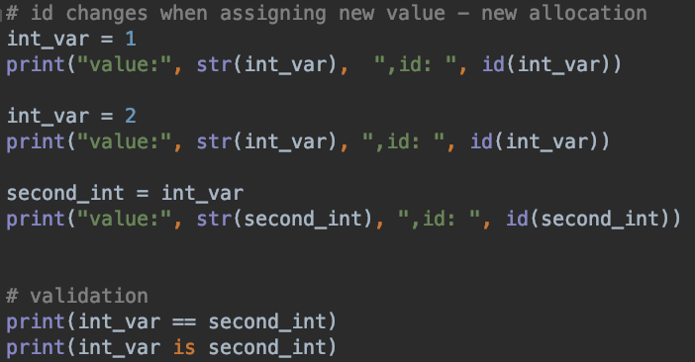
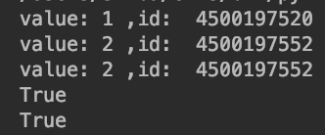
Immutable types
First assignment tries to alter the value, but it is immutable!
Thus, another address is used.
Second assignment needs no change.
Thus, they both point to the same address.

Slide 7
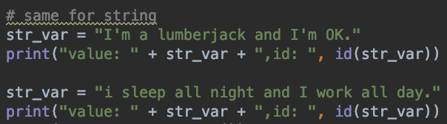
Strings are immutable
Same for strings.
Reassigning allocates new memory

Slide 8

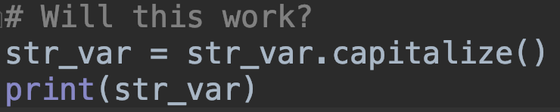
Oops
I made a grammar mistake.
Can I capitalize the first letter?
Why does it fail?
Strings are immutable, we cannot change parts
Will this work? – Yes! We allocate a whole new string.

Slide 9


Slide 10
Lists
Lists are another kind of type
As implied by the name they hold a list of items
Indexing as with strings
They have many useful methods
There are several types resembling lists (tuples, sets and dictionaries). Do not mix them up. More on that here:
https://www.w3schools.com/python/python_lists.asp

Slide 11
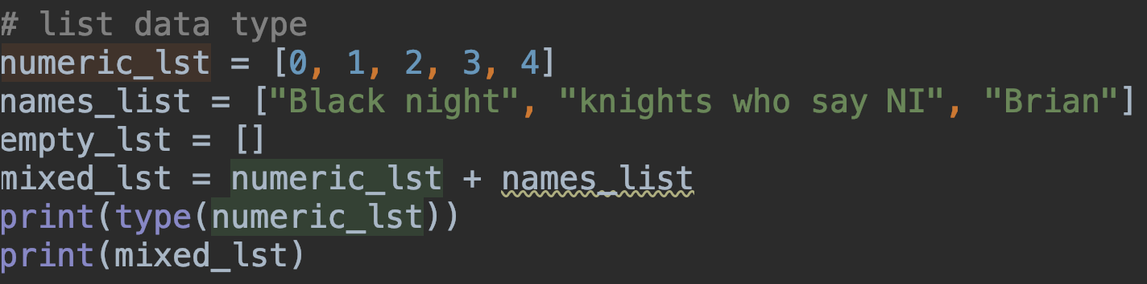
Making a list
Lists are initialized by:
lst = []
Between the parentheses put whatever you want
You can even mix it up or nest lists.

Slide 12
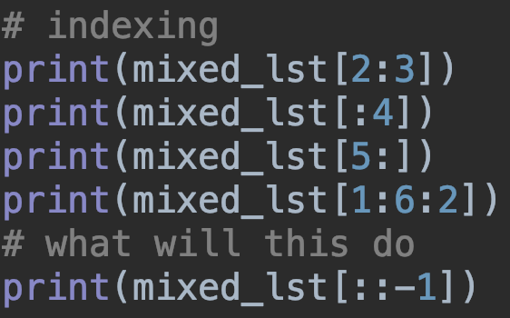
Accessing list elements
List indexing works like strings
What will the last one do?

Slide 13
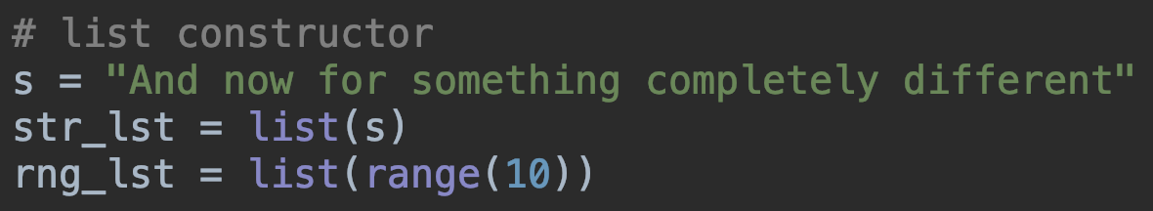
Other ways of constructing lists
A list constructor makes a list out of another data type.
Other than the basic constructor we have constructors from:
String
Range
other types

Slide 14
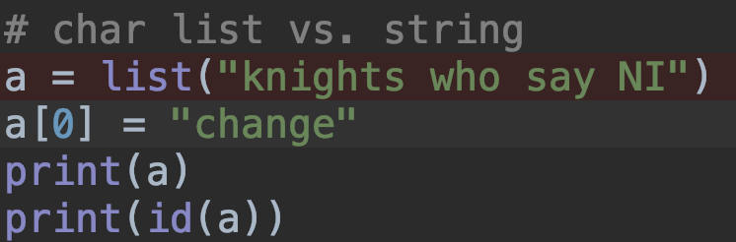
So how is a string different from a list of characters?
Different class:
Different type
Different methods
Mutability! A list is mutable, i.e. its elements change.

Slide 15
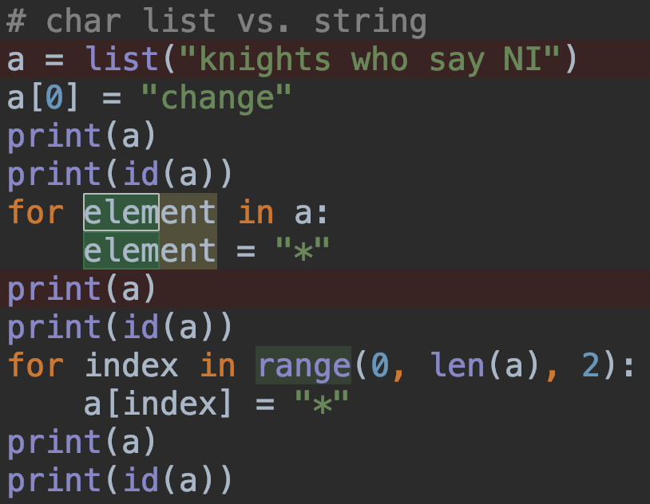
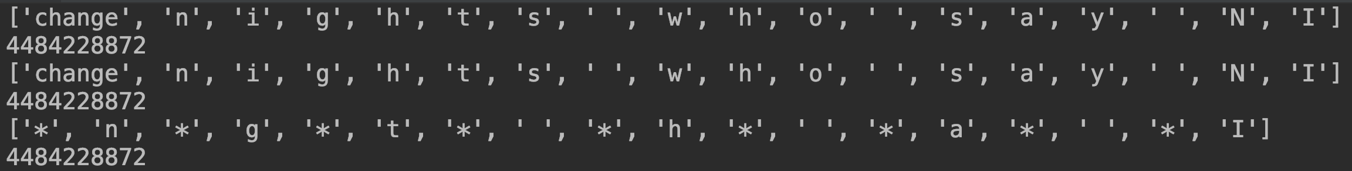
What happens here?
In the first for loop, element gets each of the list elements. These are immutable strings -> no persistent change
Second loop iterates over indices. The list itself is mutalble -> persistent change

Slide 16
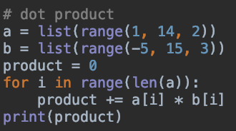

Numeric lists – Dot Product
Sums and recursive relation can be converted to loops

Slide 17
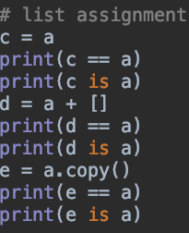
List assignment
Lists can be assigned
In what way is copying different from assignment?
Are all of these equivalent? Which is best

Slide 18
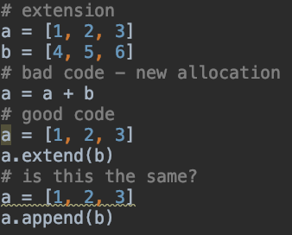
List arithmetic and extension
List can add more elements
Extending should be done using “+=“ or the extend() method to reduce allocations.
Append() is different, it adds another list as the end.

Slide 19
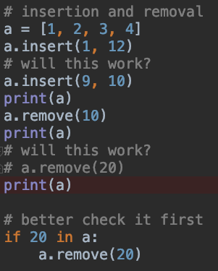
Other methods
We can remove() or insert() items.
We can sort() a list
We can clear() a list
For more methods see:
https://www.w3schools.com/python/python_lists.asp

Slide 20
Nested Loops
Loops can be nested, i.e. a list with another list being an element.
Very useful for holding complex data in an organized manner
As an example we want to build a phone book. We need:
Ability to find phone numbers by name
Each person can have one or more phone numbers
Ability to add and remove numbers

Slide 21
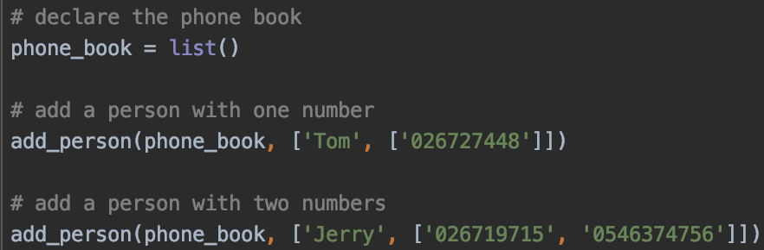
Declare the phone book, add contacts
The phone book is a nested list
Each element is a list itself which holds a name, and yet another list of numbers
Adding people by append()

Slide 22
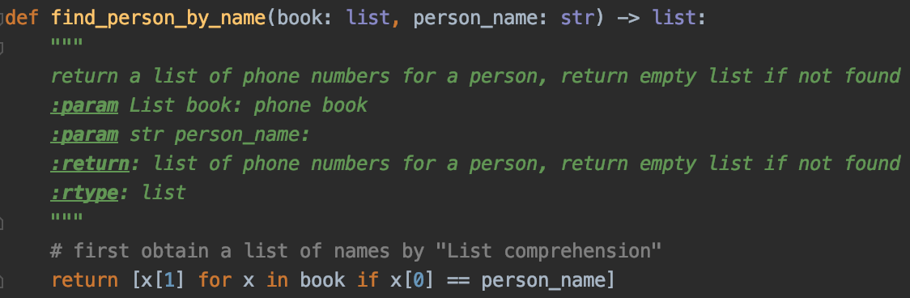
Find people by name using “"List comprehension"
List comprehension is a python way for making a new list by operating on some other list or range.
On the RHS we iterate over the phone book, and we only pick elements (x’s) which adhere to the condition.

Slide 23
Removal using “"List comprehension"
Good Code
Bad Code
Check item exists before removing
Tries to remove a missing person – Creates Overflow

Slide 24
Sending parameters - argparse
Help
Positional arguments
Optional arguments
https://docs.python.org/3/library/argparse.html

Slide 25

Argparse – four steps
Import & instantiate
Add arguments
Parse
use

Slide 26
Summary
We saw today how to:
Use lists
Use input parameters

